Slide 1
Protein Sequence Analysis - Overview
INTRODUCTION TO BIOINFORMATICS

Slide 2
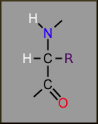
Protein Chemistry
Polymers of amino acids (alpha amino carboxylic acids)
N-terminal side
side chain
alpha carbon
C-terminal side
Side chain (R) determines properties
20 or so naturally occurring amino acids
Sequence (linear order) of amino acids determines 3D structure and function of the protein molecule

Slide 3
Amino Acids: Symbols and Properties
Amino Acid | Single Letter | Three Letter | Polarity | Charge | Side Chain Functional Group
Alanine | A | Ala | Nonpolar | Zero | Aliphatic
Cysteine | C | Cys | Polar | Zero | Thiol (sulfur)
Aspartate | D | Asp | Acidic | Negative | Carboxylate
Glutamate | E | Glu | Acidic | Negative | Carboxylate
Phenylalanine | F | Phe | Nonpolar | Zero | Aromatic
Glycine | G | Gly | Nonpolar | Zero | Aliphatic
Histidine | H | His | Basic | Positive | Aromatic (amine, imidazole)
Isoleucine | I | Ile | Nonpolar | Zero | Aliphatic
Lysine | K | Lys | Basic | Positive | Amine
Leucine | L | Leu | Nonpolar | Zero | Alphatic
Methionine | M | Met | Nonpolar | Zero | Thiol ether (sulfur)
Asparagine | N | Asn | Polar | Zero | Amide
Proline | P | Pro | Nonpolar | Zero | Imino
Glutamine | Q | Gln | Polar | Zero | Amide
Arginine | R | Arg | Polar | Positive | Guanidino
Serine | S | Ser | Polar | Zero | Hydroxyl
Threonine | T | Thr | Polar | Zero | Hydroxyl
Valine | V | Val | Nonpolar | Zero | Aliphatic
Tryptophan | W | Trp | Nonpolar | Zero | Aromatic (indole)
Tyrosine | Y | Tyr | Ala | Zero | Aromatic (phenol)
Notes:
Aliphatic = linear side c-chain

Slide 4
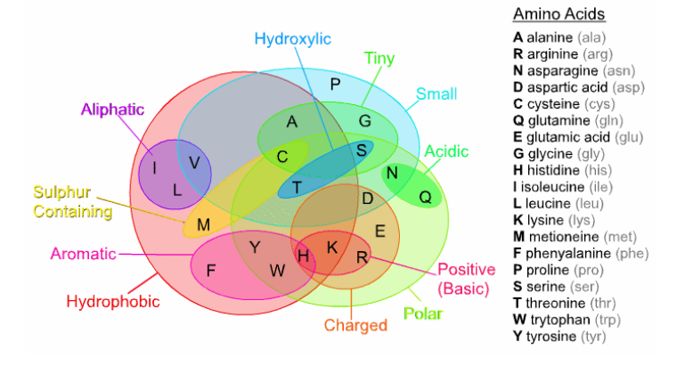
Grouping Amino Acids

Slide 5
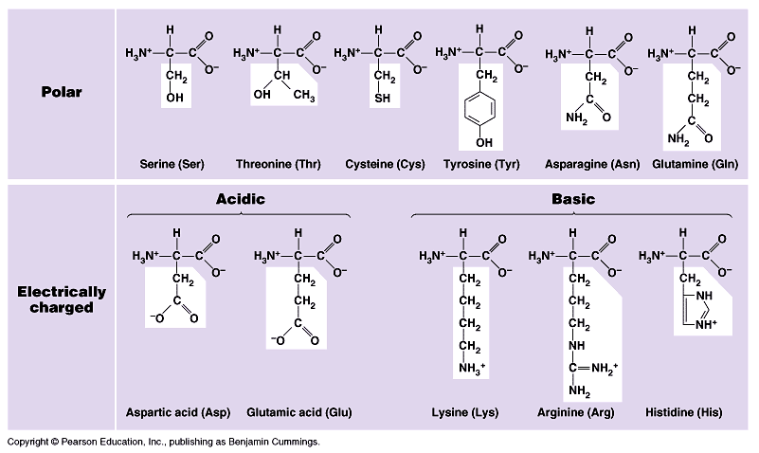
Amino Acids are classified by properties: polar, non- polar, and charged (ionic)

Slide 6
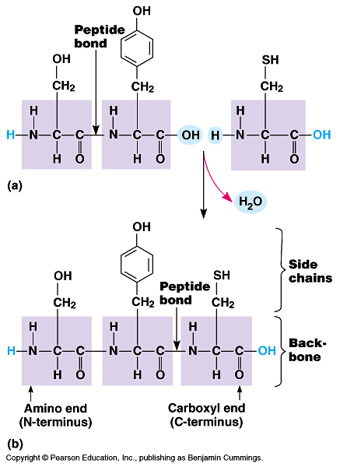
Polypeptides are constructed by condensation reactions with amino acids

Slide 7
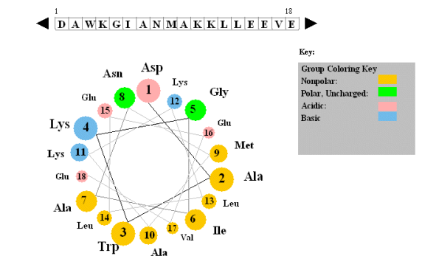
Sequence Analysis

Slide 8
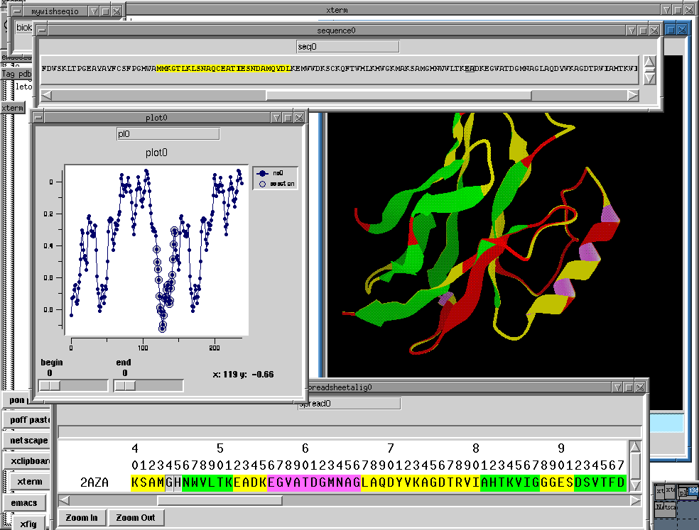
Protein Sequence

Slide 9
Chemical Properties of Proteins
Proteins are linear polymers of 20 amino acids • Chemical properties of the protein are determined by its amino acids • Molecular wt., pH, isoelectric point are simple calculations from amino acid composition
Notes:
the point at which the amino acid has no net electrical charge is isoelectric point

Slide 10
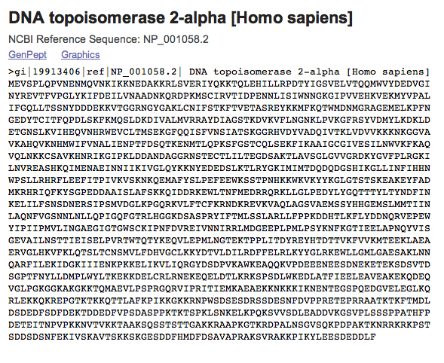
The Four Levels of Structure
Primary: Sequence

Slide 11
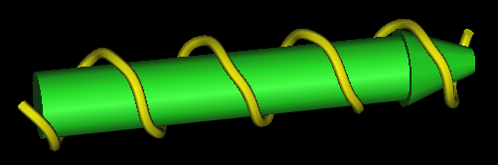

The Four Levels of Structure
Secondary:
α-helices
β-strands

Slide 12
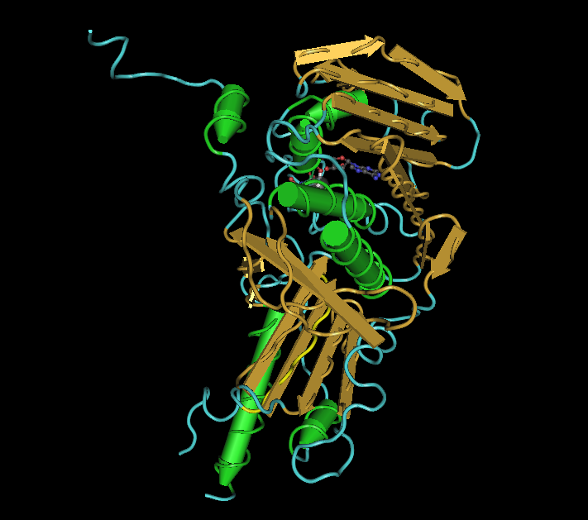
The Four Levels of Structure
Tertiary:
a “fold” of secondary structure elements

Slide 13
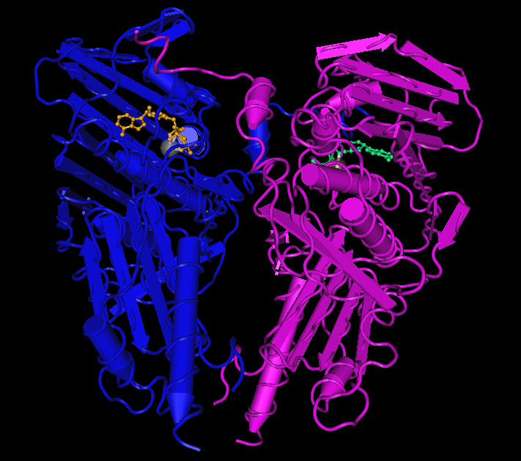
The Four Levels of Structure
Quaternary:
A complex of separate folds (often called chains)
Displayed is a dimer of the ATPase

Slide 14
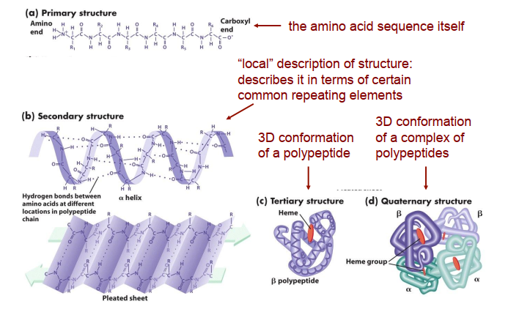
Levels of Description

Slide 15
Why Protein Structures are Important?
Proteins are fundamental components of all living cells, performing a variety of biological tasks.
Each protein has a particular 3D structure that determines its function.
Protein structure is more conserved than protein sequence, and more closely related to function.

Slide 16
Protein Structure
Protein core - usually conserved.
Protein loops - variable regions
Surface loops
Hydrophobic core

Slide 17
Proteins – The Machines in You
To keep you alive, your body must do many things…
Convert oxygen to usable energy
Digest food and recover nutrients
Build and maintain body tissue
Fight off invasions and detoxify poisons
Take out the garbage
Proteins do all of these things!
And when proteins do not work correctly…
Disease
Deformities
Death

Slide 18
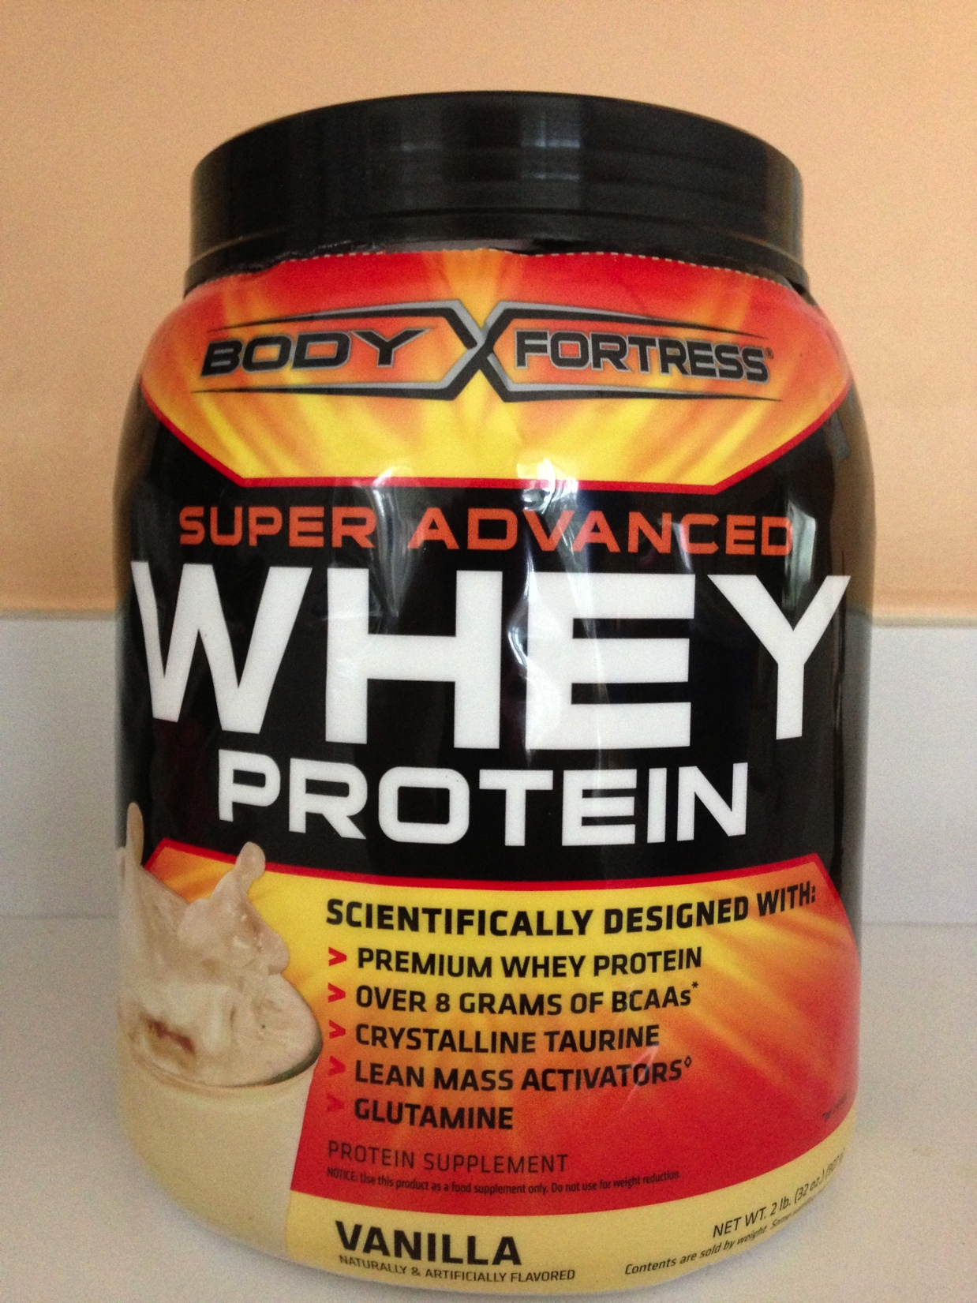
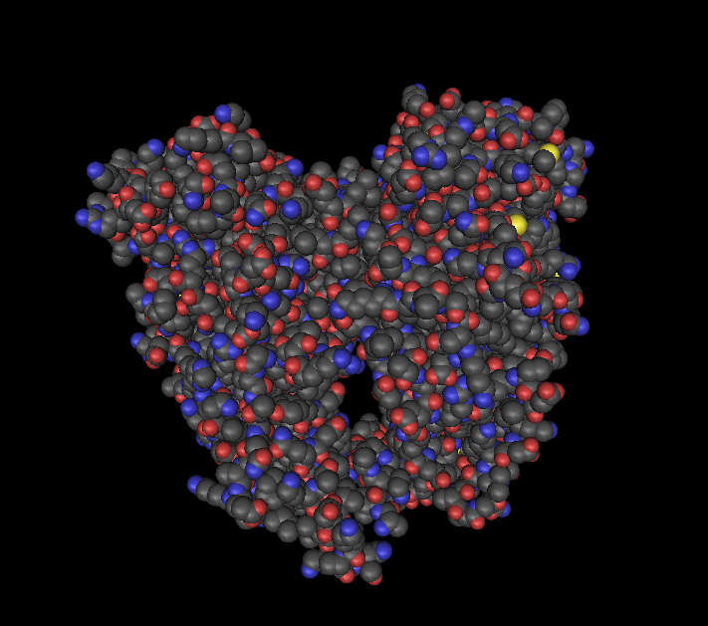
Proteins? You mean lentils?
NO!
Nutritionists, dieticians and the popular press say “protein” when they really mean “amino acids”.
When biologists say “protein”, they mean a machine!
And not just any machine, but one that performs a specific function…

Slide 19
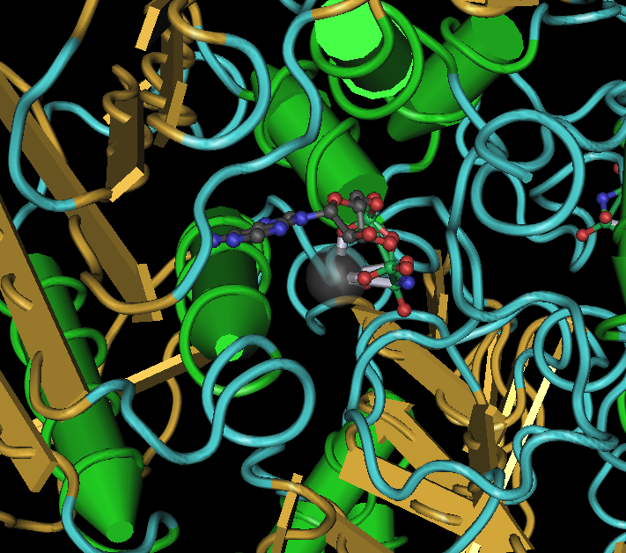
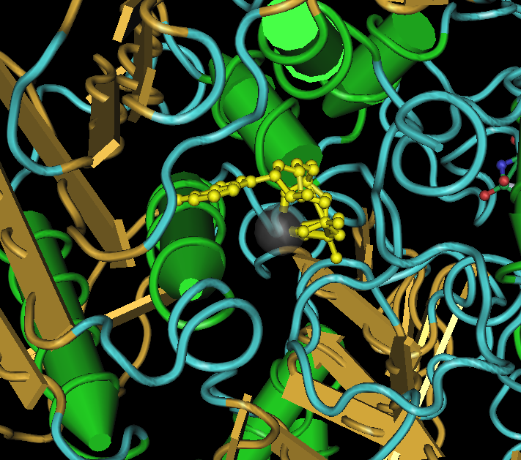
Many Proteins are Enzymes
Enzymes bind small molecules and allow a particular chemical reaction to proceed hundreds to thousands of times faster than it otherwise would.
ATPase binding an ATP analog.

Slide 20
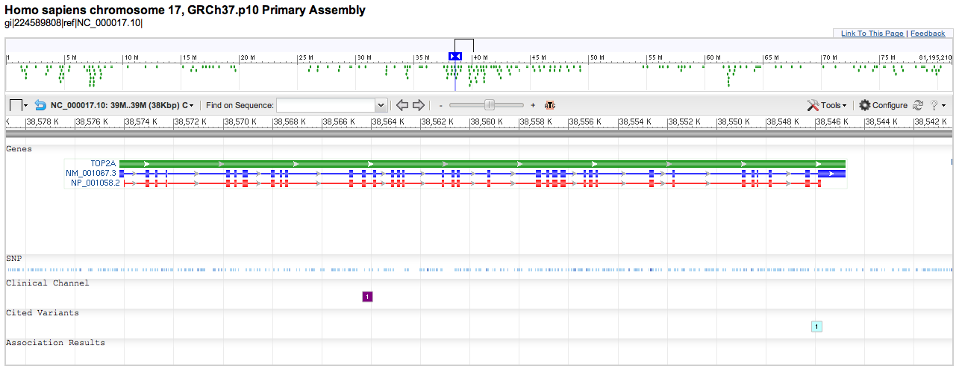
The Genetic Connection
NC_000017:c(38544773..38574202) → NM_001067 → NP_001058 → machine!
Causes drug resistance
If you change the sequence of a protein, you may change the structure.
Even a single amino acid change can break the machine!
Almost all genetic diseases are the result of a broken protein machine.

Slide 21
Important Considerations
X-ray crystallography
Requires crystals, which can be hard to make
Can handle very large proteins and complexes (e.g., ribosome)
Provides a “flash picture” with little or no data about motions
Can include packing artifacts from crystallization
NMR (Nuclear Magnetic Resonance)
Requires highly concentrated, protein solutions
Limited to relatively small proteins (<30 kDa)
Sensitive to molecular motions
High protein concentrations may induce non-biological binding

Slide 22
Computational methods for Protein Structure Prediction
Homology or Comparative Modelling
Fold Recognition or threading Methods
Ab initio methods that utilize knowledge-based information
Ab initio methods without the aid of knowledge-based information

Slide 23
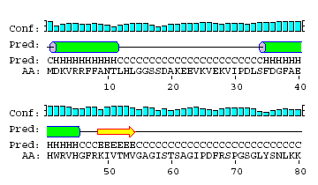
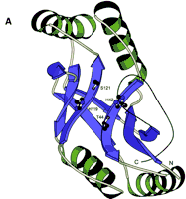
Protein structure prediction
Programs can predict secondary structure information with 70% accuracy
Homology modeling - prediction of ‘target structure from closely related ‘template’ structure

Slide 24
Comparing proteins
Amino acid sequence of protein generated from proteomics experiment
e.g., protein fragment DTIKDLLPNVCAFPMEKGPCQTYMTRWFFNFETGECELFAYGGCGGNSNNFLRKEKCEKFCKFT
Amino-acids of two sequences can be aligned and we can easily count the number of identical residues (or use an index of similarity) to find the % similarity.
Proteins structures can be compared by superimposition

Slide 25
Why do we need computational approaches?
The goal of research in the area of structural genomics is to provide the means to characterize and identify the large number of protein sequences that are being discovered
Knowledge of the three-dimensional structure
helps in the rational design of site-directed mutations
can be of great importance for the design of drugs
greatly enhances our understanding of how proteins function and how they interact with each other, e.g., explain antigenic behaviour, DNA binding specificity, etc
Structural information from x-ray crystallographic or NMR results
obtained much more slowly.
techniques involve elaborate technical procedures
many proteins fail to crystallize at all and/or cannot be obtained or dissolved in large enough quantities for NMR measurements
The size of the protein is also a limiting factor for NMR
With a better computational method this can be done extremely fast.

Slide 26
Alignment in Homology Modeling
Sequence alignment is central technique in homology modeling
Used in determining which areas of the reference proteins are conserved in sequence
Hence suggesting where the reference proteins may also be structurally conserved
After SCRs are found,it is used to establish one to one correspondence between the amino acids of reference proteins and the target in SCRs
Thus providing basis of the transforming of coordinates from the reference to the model

Slide 27
Determining Structurally Conserved Regions (SCRs)
When two or more reference protein structures are available
Establish structural guidelines for the family of proteins under consideration
First step in building a model protein by homology is determining what regions are structurally conserved or constant among all the reference proteins
Target protein is supposed to assume the same conformation in conserved regions
SCRs are region in all proteins of a particular family that are nearly identical in structures.
Tend to be at inner cores of the proteins
Usually contains alpha-helices and beta sheets

Slide 28
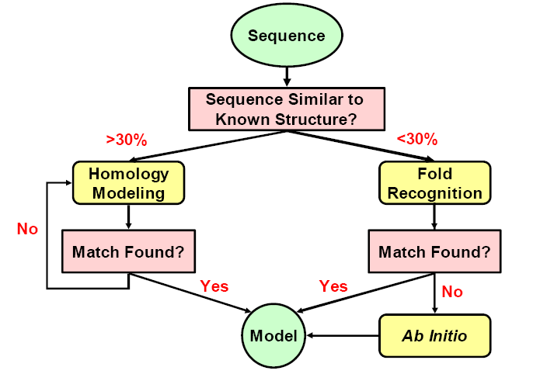
Summary
http://www.cs.cmu.edu/~cjl/teaching/15872AS05/

Slide 29
Protein Bioinformatics: Protein sequence analysis
Helps characterize protein sequences in silico and allows prediction of protein structure and function
Statistically significant BLAST hits usually signifies sequence homology
Homologous sequences may or may not have the same function but would always (very few exceptions) have the same structural fold
Protein sequence analysis allows protein classification

Slide 30
Development of protein sequence databases
Atlas of protein sequence and structure – Dayhoff (1966) first sequence database (pre-bioinformatics). Currently known as Protein Information Resource (PIR)
Protein data bank (PDB) – structural database (1972) remains most widely used database of structures
UniProt – The United Protein Databases (UniProt, 2003) is a central database of protein sequence and function created by joining the forces of the SWISS-PROT, TrEMBL and PIR protein database activities

Slide 31
Protein sequence alignment
Pairwise alignment
a b a c d
a b _ c d
Multiple sequence alignment usually provides more information
a b a c d
a b _ c d
x b a c e
Multiple alignment difficult to do for distantly related proteins

Slide 32
Protein sequence analysis overview
Protein databases
PIR and UniProt
Searching databases
Peptide search, BLAST search, Text search
Information retrieval and analysis
Protein records at UniProt and PIR
Multiple sequence alignment
Secondary structure prediction
Homology modeling

